Slide 1


Lesson 13 Prediciting the future
UNIT 4

Slide 2
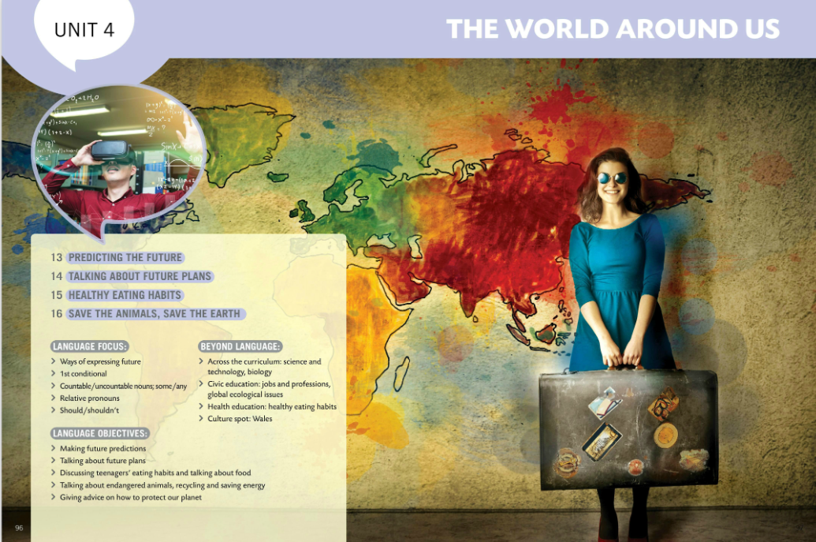
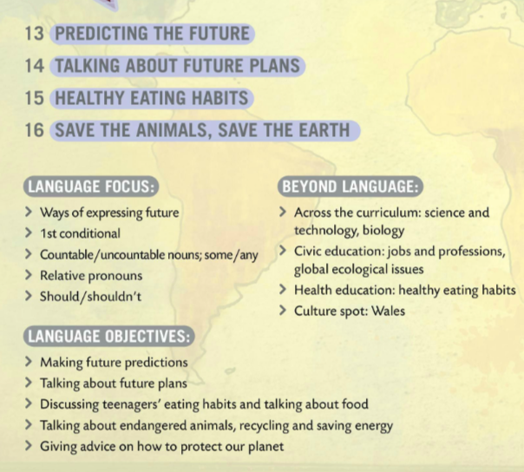
In this unit you will learn about

Slide 3
Tongue Twisters
Say these tongue twister slowly, then faster. How fast can you say them? How many times?
1 Not these things here, but those things there.
2 She sells seashells by the seashore.
3 Red lorry, yellow lorry.
4 Copper-bottomed coffee pot.
5 I saw a kitten eating chicken in the kitchen.
6 She sees cheese.
7 Black background, brown background.
8 How much wood would a woodchuck chuck if a woodchuck could chuck wood?

Slide 4
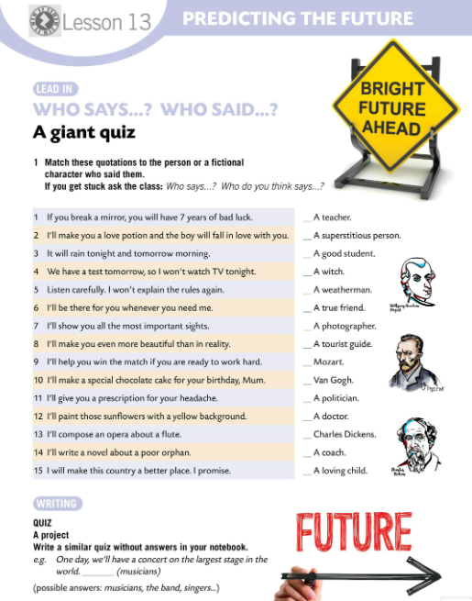
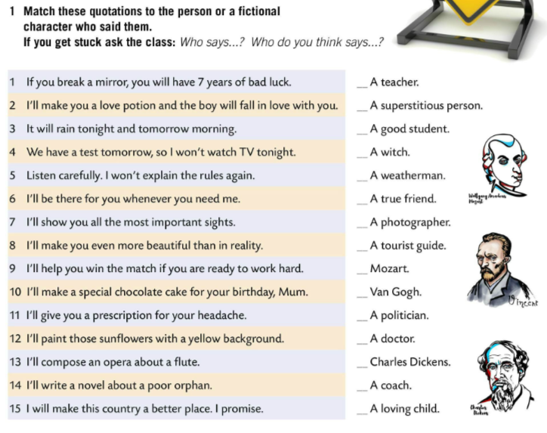
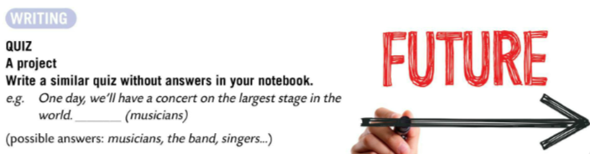
Match these quotations to the personal or a fictional character who said them.
If you get stuck ask the class: Who says..?
5
1
4
2
Check.
3
6
8
7
QUIZ – A PROJECT
Make a similar quiz without answers in your notebook.
e.g. One day, we’ll have a concert on the largest stage in the world. ____ (possible answer: musicians)
13
12
15
11
14
9
10

Slide 5
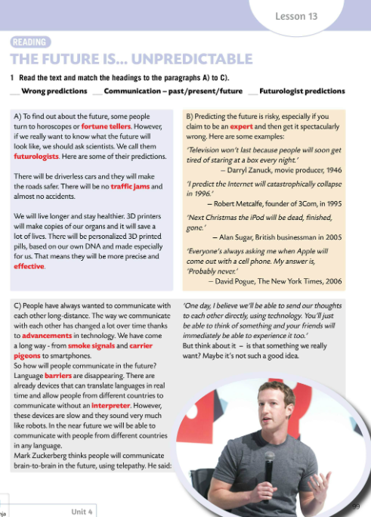
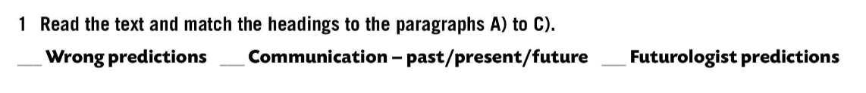
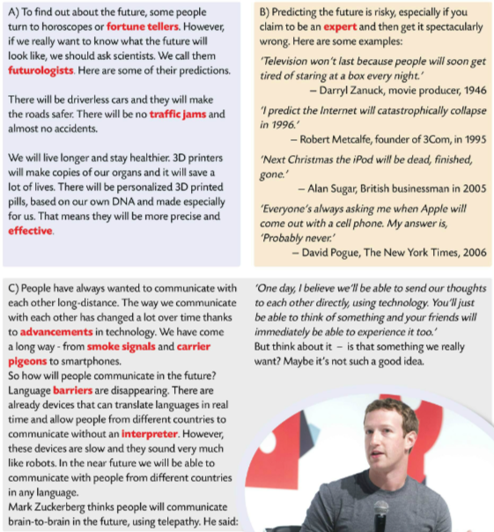
Read the text and match the headings to the paragraphs A) to C).
B
C
A
Check.
Read the text one more time. This time underline the new words and translate them into Croatian.

Slide 6
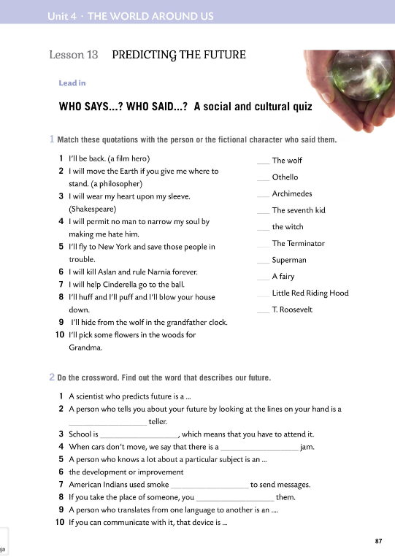

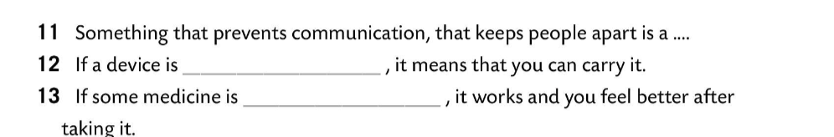
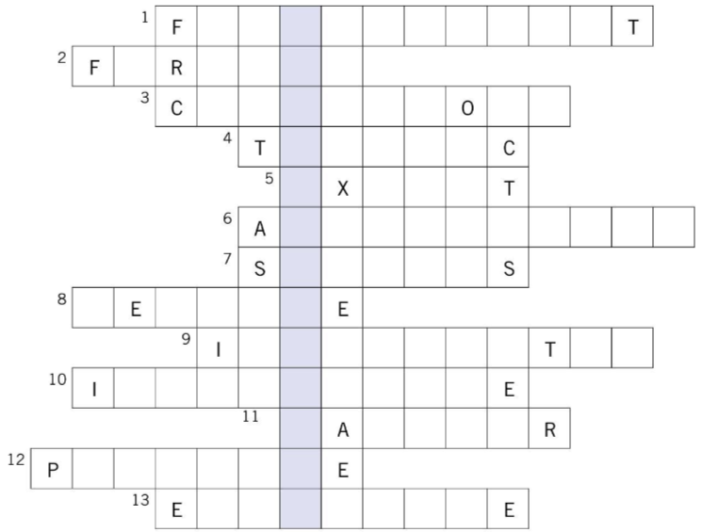
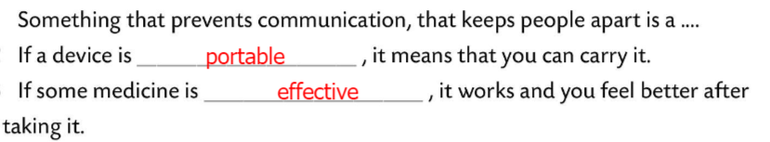
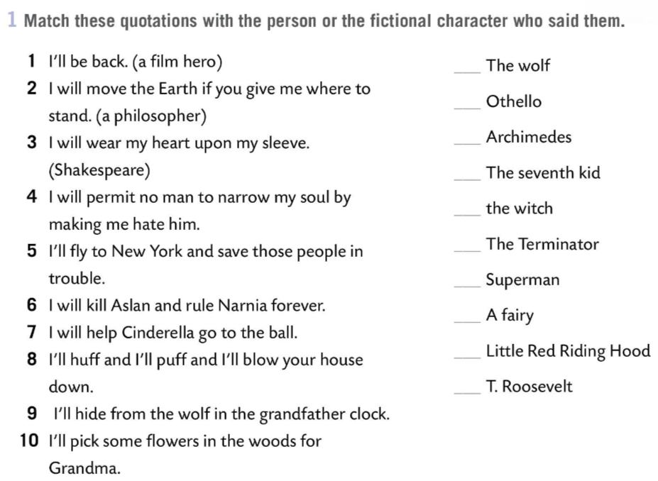
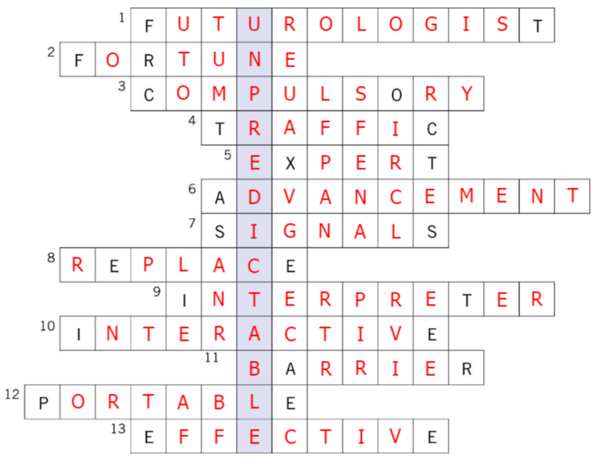

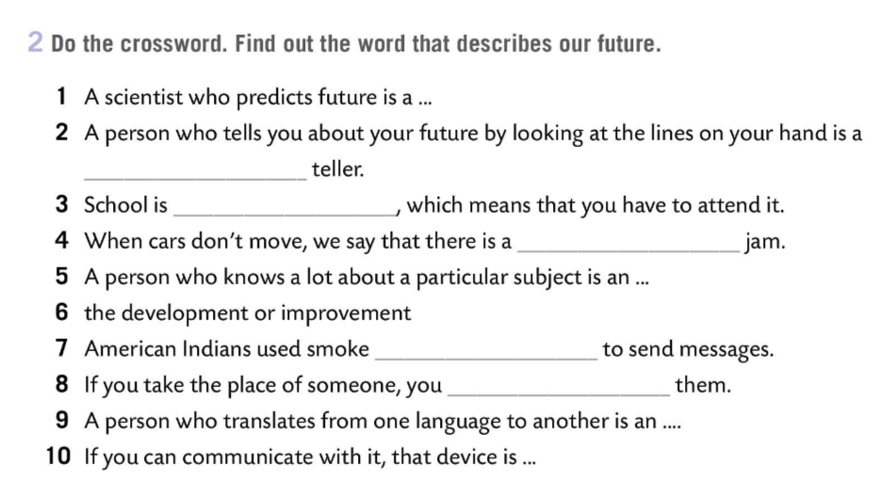
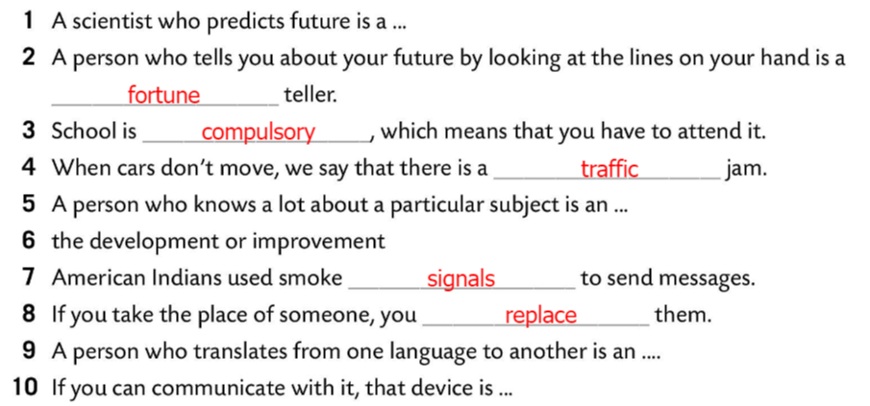
Workbook, page 87
Match these quotations with the person or the fictional character who said them.
Check.
Do the crossword. Find out the word that describes our future.
Check.

Slide 7
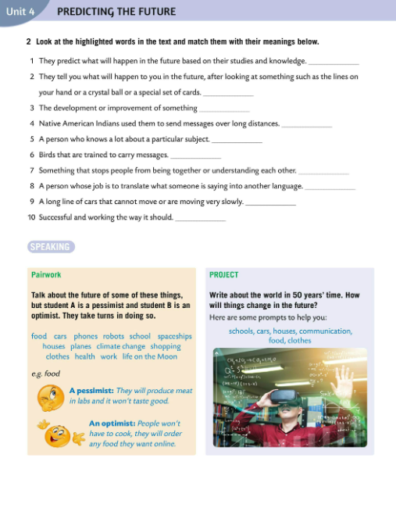
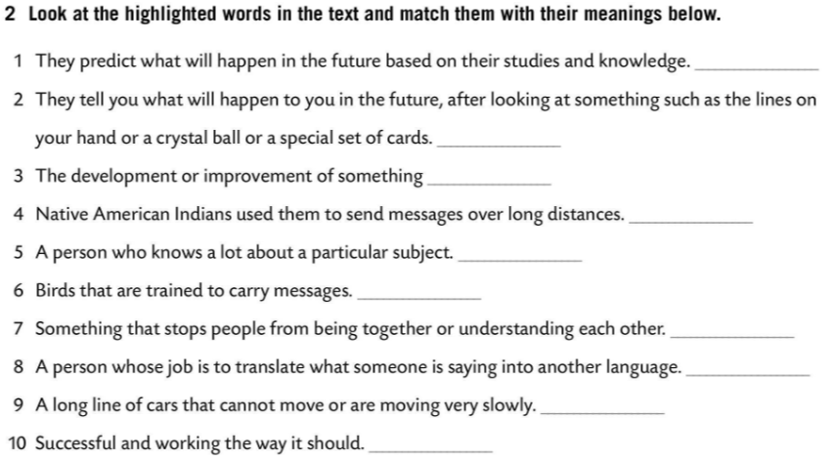
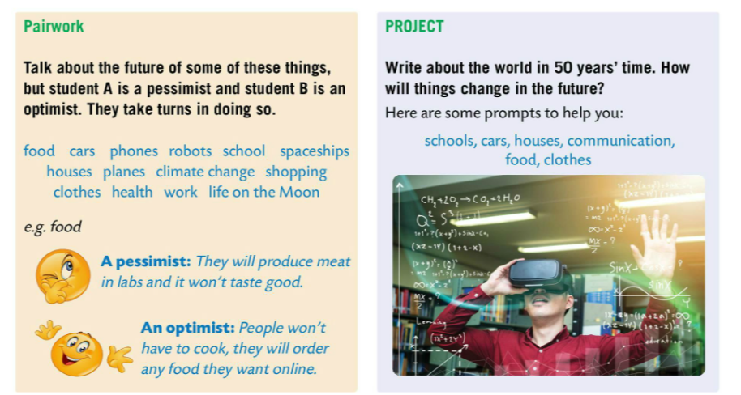
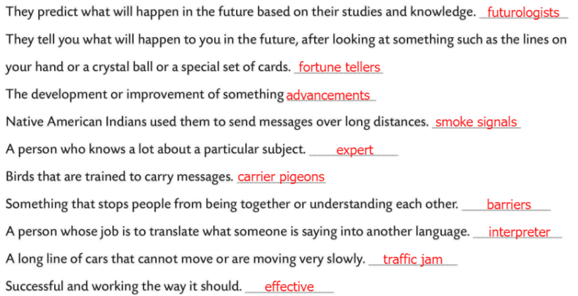
Look at the highlighted words in the text and match them with their meanings below.
Check.
PAIRWORK
Talk about the future of some of these things. Student A is a pessimist and student B is an optimist. Take turns in doing so.
PROJECT
Write about the world in 50 years’ time. How will things change in the future?

Slide 8
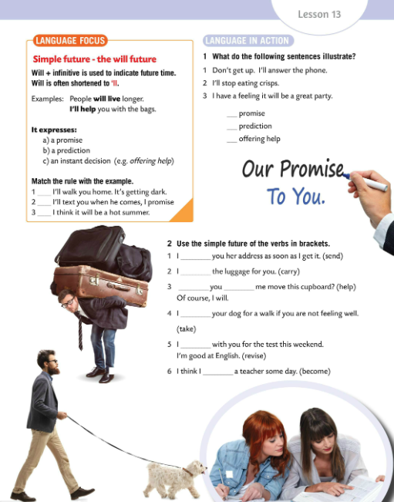
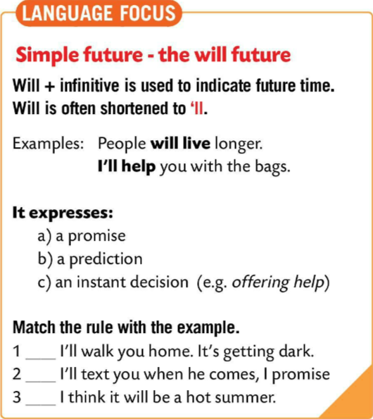
LANGUAGE FOCUS
We use WILL + INFINITIVE to indicate future time called SIMPLE FUTURE. Will is often shortened to ‘ll.
Za izricanje budućnosti koristimo WILL + INFINITIV i to glagolsko vrijeme naziva se future simple. Will je često skraćeno u ‘ll.
e.g. People will live longer.
I’ll help you with the bags.
It expresses: a promise, a prediction and an instant decision (offering help).
Njime izražavamo: obećanja, predviđanja i odluke donesene na licu mjesta (ponuda pomoći).

Slide 9
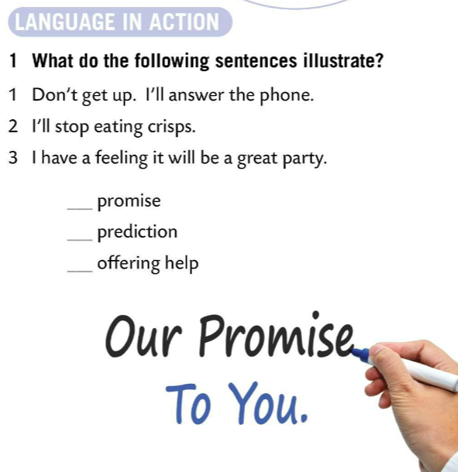
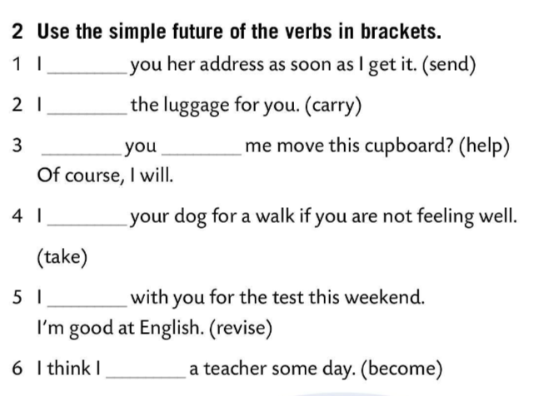


Match the rule with the example.
Check.
will send
What do the following sentences illustrate?
will carry
Will
help
Check.
will take
Use the simple future of the verbs in brackets.
will revise
will become
Check.

Slide 10
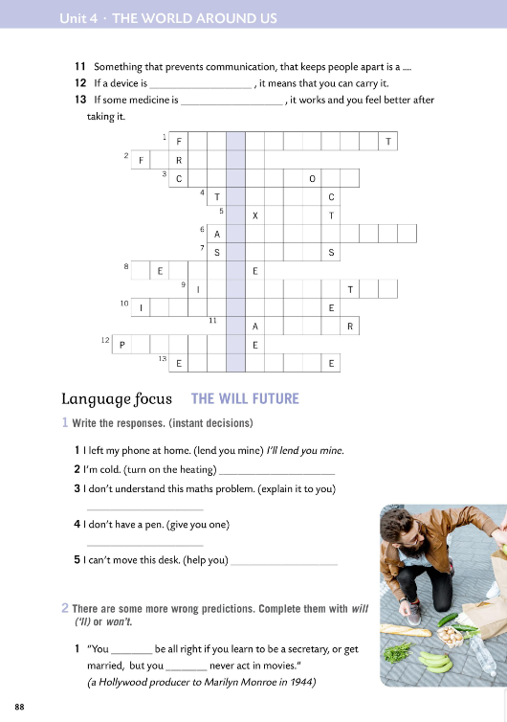
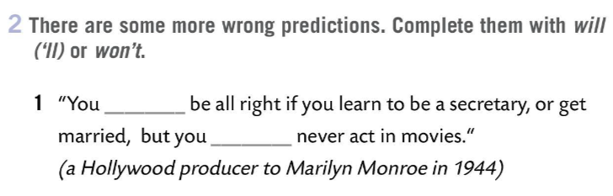
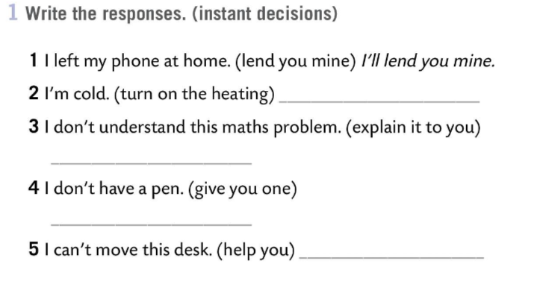
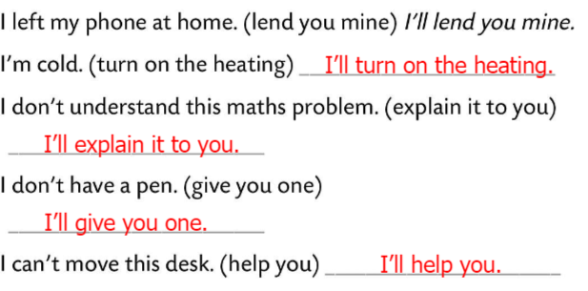

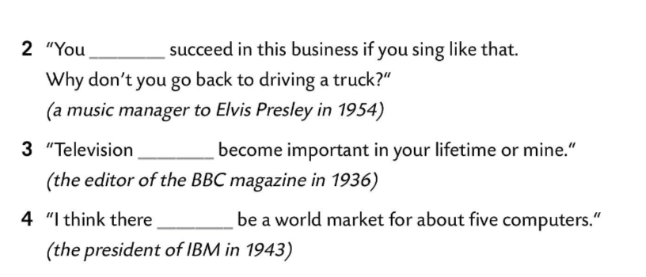
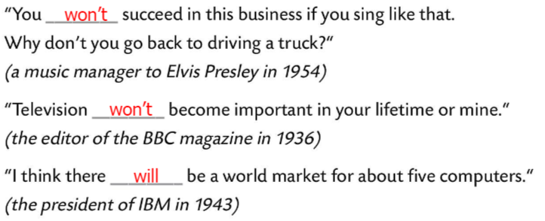
Workbook, page 88
Write the responses. (instant decisions)
Check.
There are some more wrong predictions.
Complete them with WILL (‘LL) or WON’T.
Check.

Slide 11
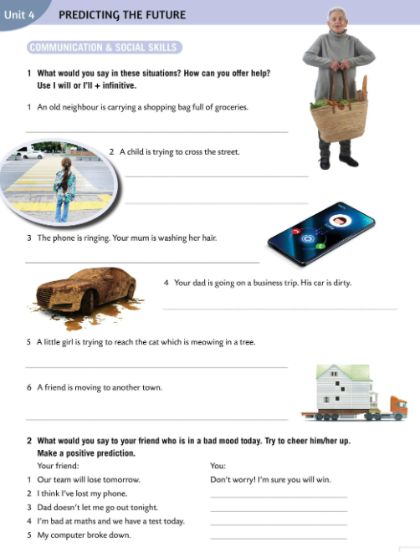
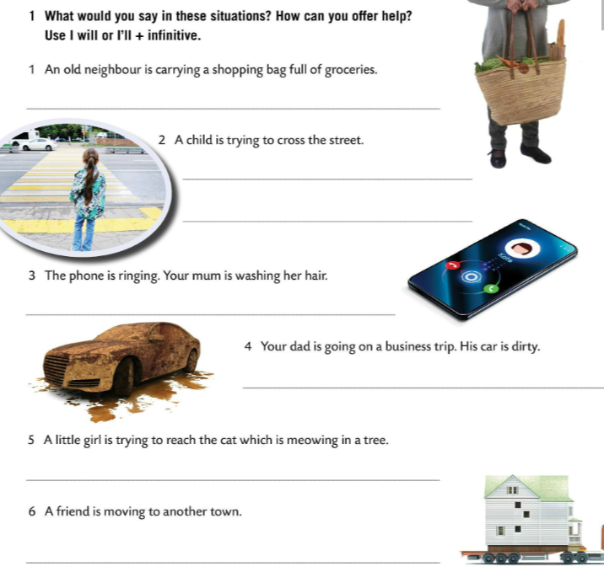
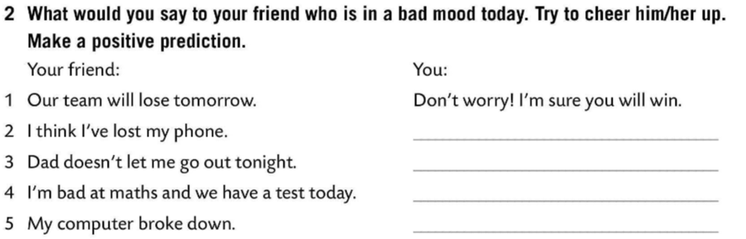
What would you say in these situations?
How can you offer help?
Use I WILL OR I’LL + INFINITIVE.
I’ll help you carry the bag.
I’ll help you cross the street.
Check.
I’ll answer it.
What would you say to your friend who is in a bad mood today?
Try to cheer him/her up.
Make a positive prediction.
I’ll wash your car.
I’ll get your cat down (from the tree).
I’ll be in touch.
Share your answers with the class.

Slide 12
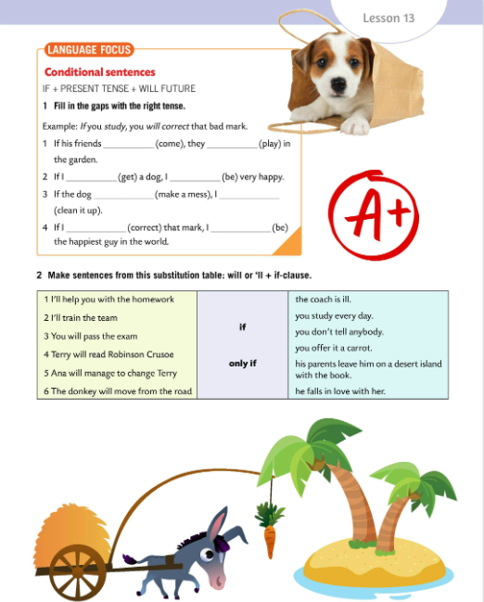
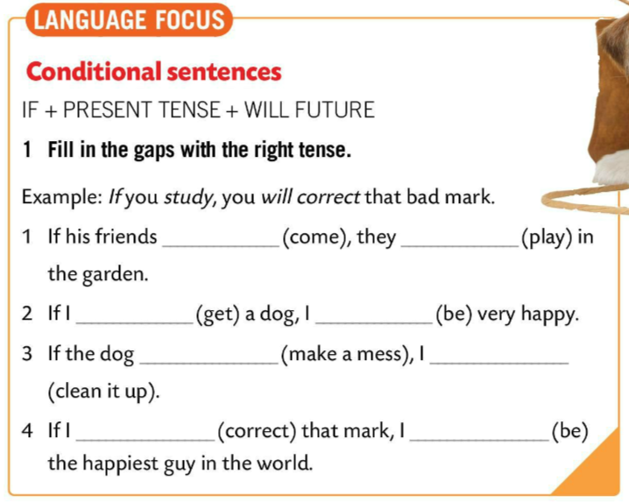
LANGUAGE FOCUS
We use the first conditional when we talk about future situations we believe are real or possible.
Kondicional prvi je glagolski način kojeg koristimo kako bismo izrazili neku stvarnu mogućnost, koja se lako može ostvariti. Pri tome navodimo uvjet pod kojim bi se to moglo ostvariti.
In first conditional sentences, the structure is usually
IF/WHEN + PRESENT SIMPLE + WILL + INFINITIVE
Prvi kondicional se tvori od
if + present simple+will + glagol u infinitivu.

Slide 13
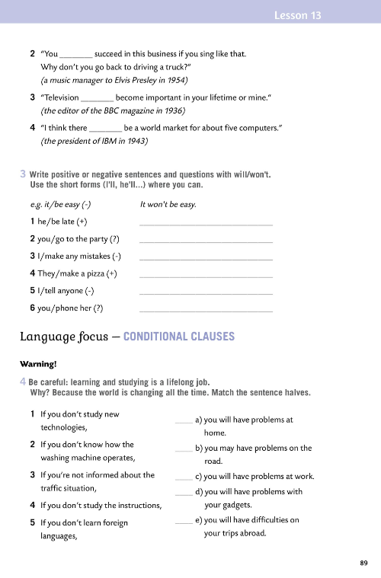
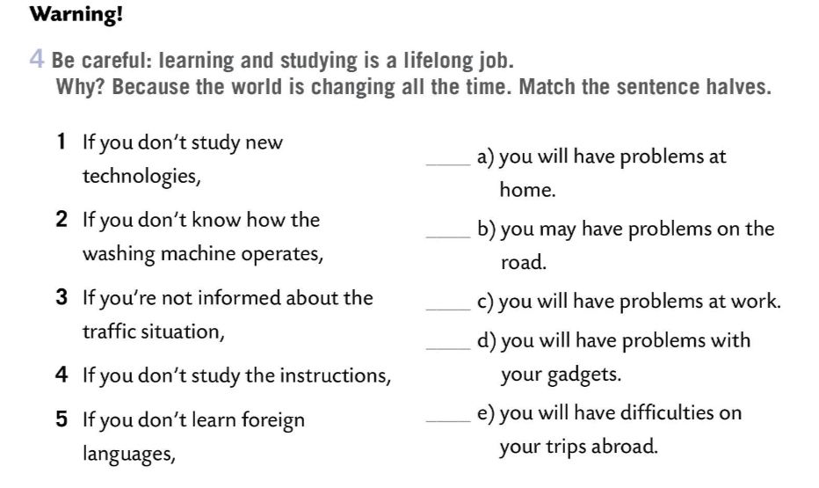
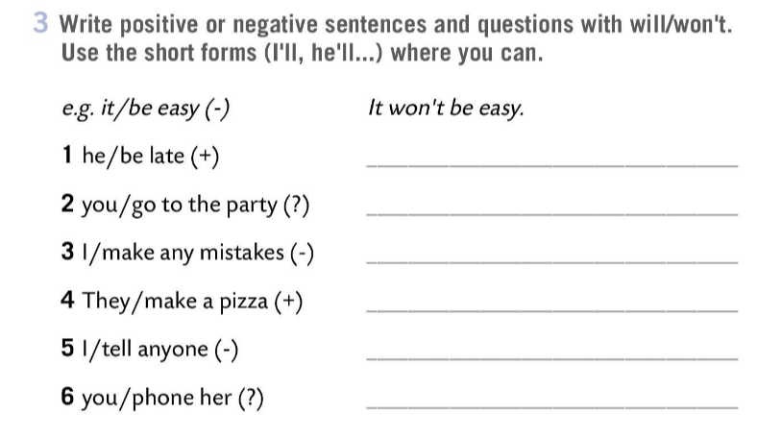
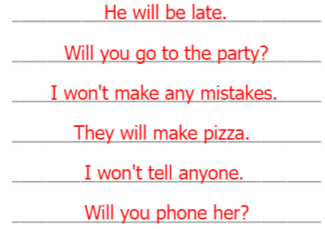

Workbook, page 89
Write positive or negative sentences and questions with will/won’t.
Use short forms (I’ll, he’ll) where you can.
Check.
Be careful: learning and studying is a lifelong job.
Why? Because the world is changing all the time.
Match the sentence halves.
Check.

Slide 14
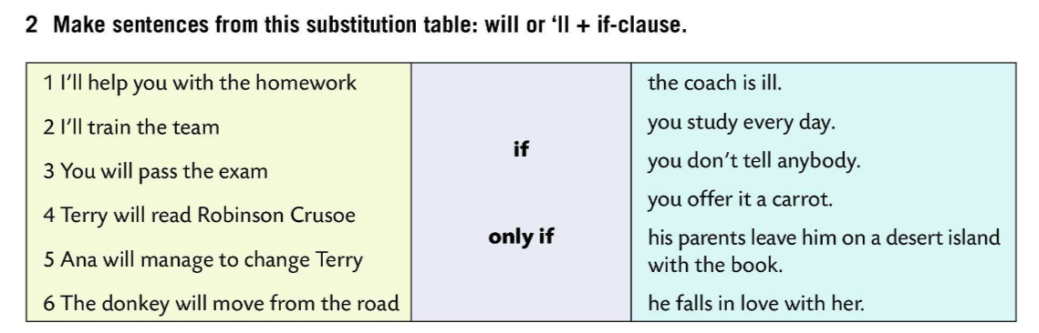
Look at the example and then fill in the gaps with the right tense.
Check.
Make sentences from this substitution table: will or ‘ll + if-clause.
come
will play
get
Check in class.
will be
makes a mess
will clean it up
correct
will be
Complete the sentences to score your knowledge of the FIRST CONDITIONAL.
https://wordwall.net/play/850/040/137

Slide 15
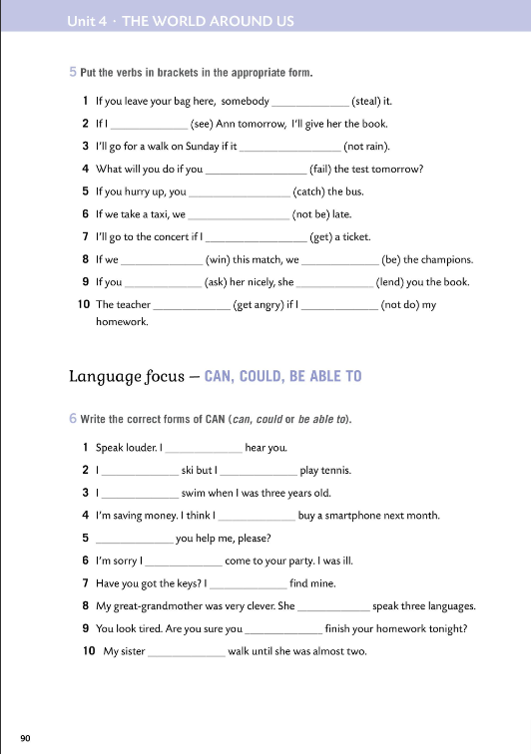
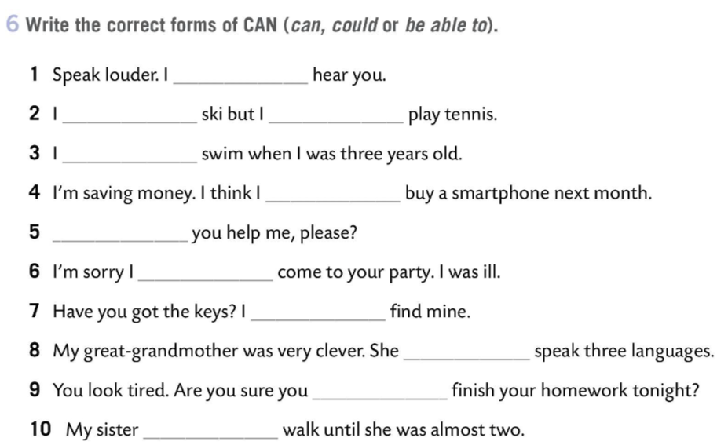
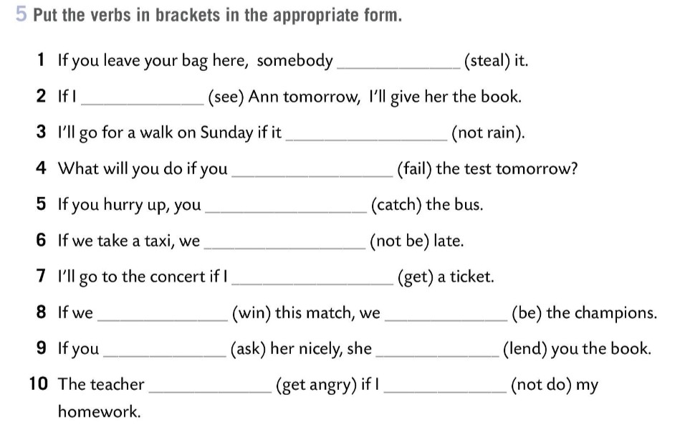
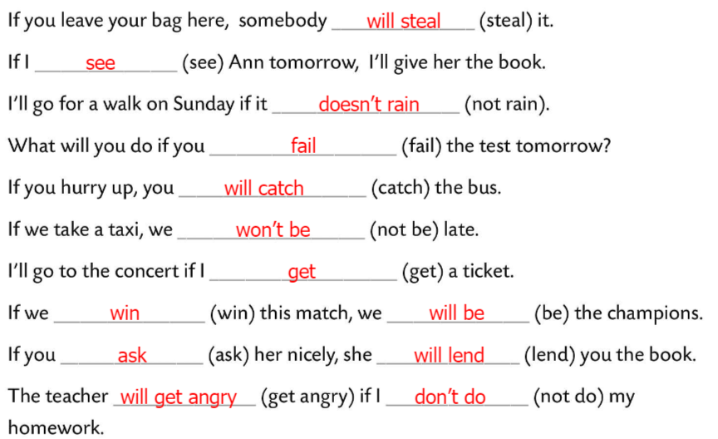
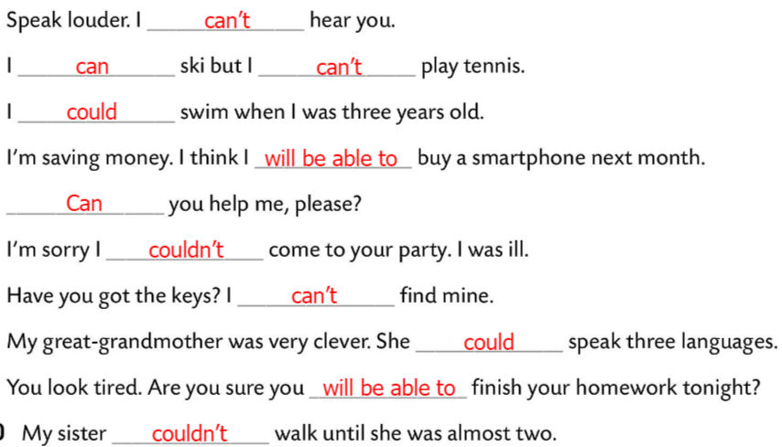
Workbook, page 90
Put the verbs in brackets in the appropriate forms.
Check.
Write the correct forms of CAN (can, could or be able to).
Check.

Slide 16
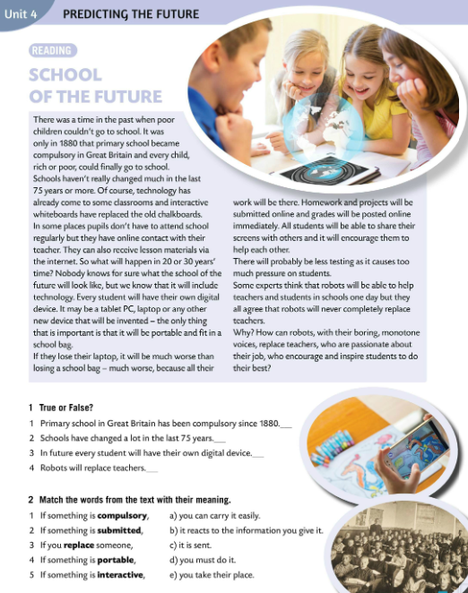
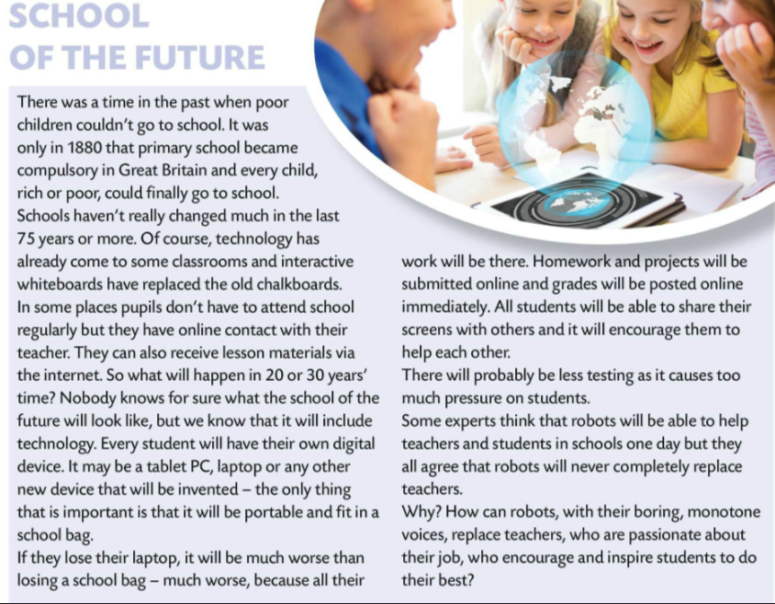
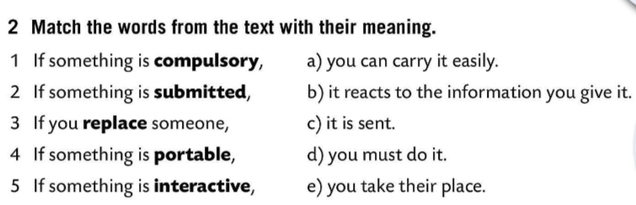
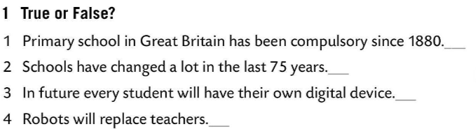
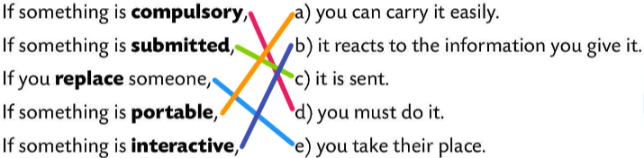
Read the text. Do Task 1.
Check.
Read the text again. Do Task 2. Match the words from the text with their meaning.
T
F
T
F
Check.

Slide 17


LANGUAGE FOCUS
We use CAN to express ability in the present. CAN (znati, moći) koristimo za izražavanje mogućnosti (sposobnosti) u sadašnjosti.
He can play tennis well, but he can’t cook.
We use COULD to express past abilities.
COULD (znao/la sam, mogao/la sam) koristimo za izražavanje sposobnost i mogućnosti u prošlosti.
He could read when he was six, but his brother couldn’t.
We use BE ABLE TO for a specific point in time (past, present or future).
BE ABLE TO (biti u mogućnosti) koristimo kada govorimo o točno određenom događaju ili situaciji u prošlosti, sadašnjosti ili budućnosti.

Slide 18


Use the right form – can, could, be able to…
Check.
can
could
Write about your abilities.
was able
will be able
Can
could

Slide 19


Workbook, page 91
What do you think schools in the future will look like? Write.

